Slide 1

Are we fully meeting the needs of our riders?
How can we create more value to increase membership?

Slide 2
Why are many riders choosing casual/daily passes?
How are they using it differently?
Casual riders ride more recreationally while members ride for commute?
Weather and season have an effect
Can we offer different types of memberships? Can we survey riders to see why they do or don’t subscribe?

Slide 3
How we measured data:
-members = those with annual membership
-casual = riders with daily/ hourly purchase
-includes rides from Dec 2024-Jan 2025*
*data has been made available by Motivate International Inc. under license

Slide 4
-average trip duration in minutes
-average trips per weekday, busiest weekdays
-minimum, maximum trip durations
-dates, finding averages for each month over a 1 year period
STATS

Slide 5
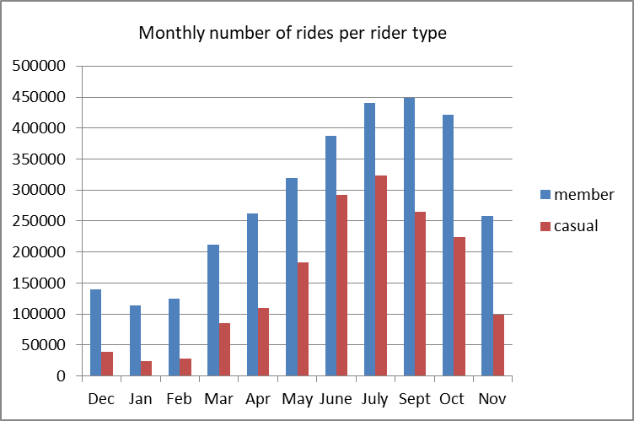
The Data Shows:
The busiest times of the year are in the summer months
The number of casual riders shows a lot of engagement & interest
The winter months have the least amount of casual riders*
*data has been made available by Motivate International Inc. under license

Slide 6
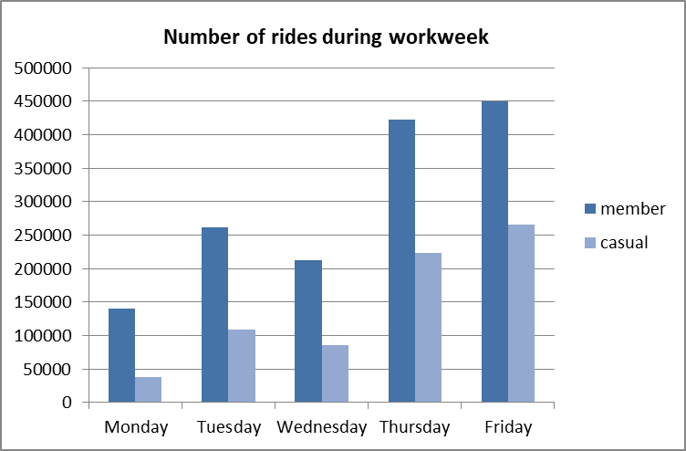
Casual ridership is highest near the weekend
Member ridership is higher overall daily
30% use our bikes to commute to work each day*
*data has been made available by Motivate International Inc. under license

Slide 7
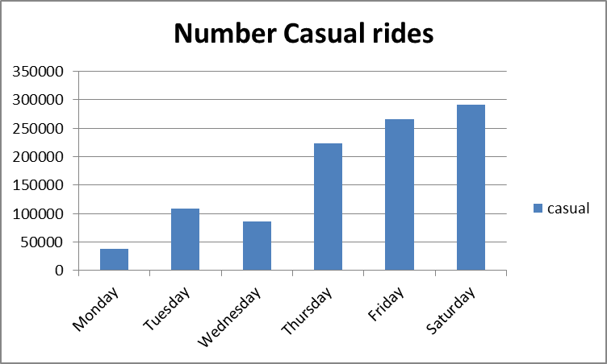
What does it all mean?:
Casual riders may not see a benefit to paying for a membership
Limited options deter them from subscribing annually

Slide 8
Recommendation:
What can Cyclistic do?
-offer tiered membership based on rider needs
-offer seasonal pass for summer riders
-create promotions or free trial period leading up to summer months
-offer discounts on winter months

